Slide 1


Evaluating Gun Violence Incidence in New York City
Rachel Weber
Capstone Proposal Dec. 2019

Slide 2
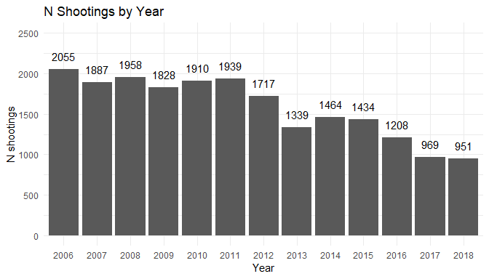
Introduction
NYC has had a steady decline in shootings over the past 12 years
In 2018, NYC had their first shooting-free weekend in decades
Was this a miraculous event or was it becoming more inevitable?

Slide 3
Introduction
SAFE Act
NYC has had a steady decline in shootings over the past decade
In 2018, NYC had their first shooting-free weekend in decades
Was this a miraculous event or was it becoming more inevitable?
The SAFE Act was passed in January 2013. Did this have a measurable impact on gun violence?

Slide 4
The Data
NYC’s Open Data program provides downloadable files documenting each shooting that occurs in the city’s boundaries.
Contained in the data:
Date and time of shooting
Location (precinct, longitude, latitude, burrow)
Shooter/victim demographics
Data span 2006 to 2018 and are updated quarterly

Slide 5
Aims and Hypotheses
Aim 1: Ascertain if the shooting-free weekend in NYC in October 2018 was an anomaly or if it was expected to happen.
Hypothesis 1: Given enough weekends, the shooting-free weekend was expected.
Aim 2: Build a negative binomial model to predict the number of shootings expected on a given day
Hypothesis 2: Day of the week is a significant predictor of the number of shootings estimated to occur
Hypothesis 3: Safe Act passage decreased the total number of expected shootings.

Slide 6
Data Analysis
All data was verified before upload by NYC, therefore data quality/accuracy checks aren’t needed. There is no missingness in the date and time variables, so I do not need to address missing data before analysis.
Aim 1:
Do manual probability calculations to determine the odds of a consecutive Friday, Saturday, and Sunday having zero shootings.
use conditional probability calculations to calculate the probabilities for Saturday and Sunday
Aim 2:
Negative Binomial model to predict the number of shootings on a given day
Start with simple model with categorical variable for Day
Second model with just binary SAFE Act passage variable
Add precision variables after checking colinearity

Slide 7

Anticipated Products
Probability of shooting-free weekend occurring (single value)
Model that can be used to predict number of shootings expected in a day
Discussion of SAFE Act on reduction in gun-violence

